Slide 1
Saber Design
Neil Wang

Slide 2
Background
Experts for legacy automation framework left S1, no maintenance/sharing
S1 team needs automation scripts created base on clean/simple base for new features
New scripts can run on Galaxy
VB vs. C#
ini vs. XML
Two complicated to maintain vs. Light weight

Slide 3
Project Introduction
The project name: Galaxy（Whole project）
The Web UI: Galaxy 银河
The ATF：Force 原力
The S1 Test Lib：(Light) Saber （光）剑
It’s a huge project which can not be completed in short time with little resource. Take the task with higher priority which bring most value to team.

Slide 4
Saber Design Considerations
Easy to understand/use/maintain
Isolate the input parameters with the native API parameters(Future API changes)
User-Friendly enum name/constant params(mapping between native API and Saber)
Clean/Simple constructor for common user
Complete/powerful constructor for advanced user
Data driven
Deserialization from file or XElement

Slide 5
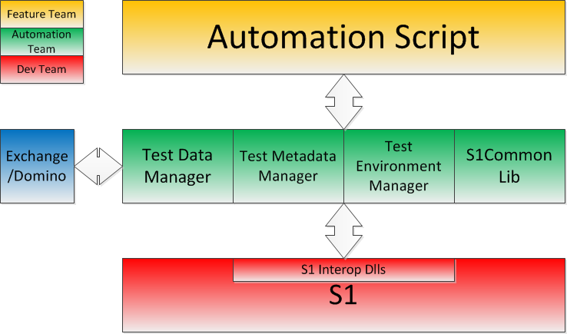
Saber – Low Layer of Galaxy

Slide 6
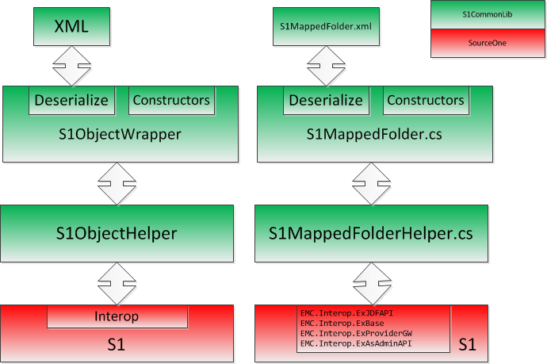
S1 Common Lib Design

Slide 7
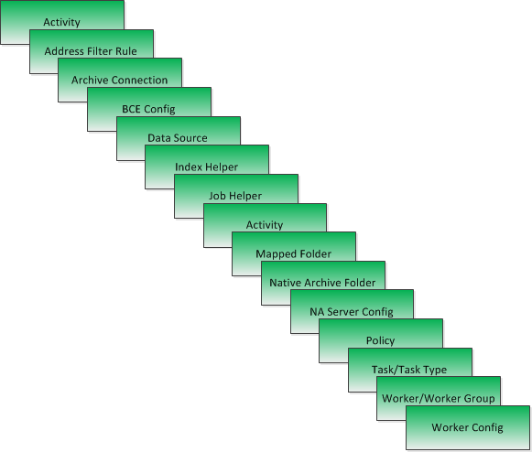
Modules Wrapped in C#

Slide 8
Demo

Slide 9
Next Step
Test Data Management
Integrated with Force/Debug
Code Review for common lib
Test for common lib
Add necessary more functionalities to common lib
Run activity/monitor the finish
Index
Search

Slide 10
QA

